Slide 1
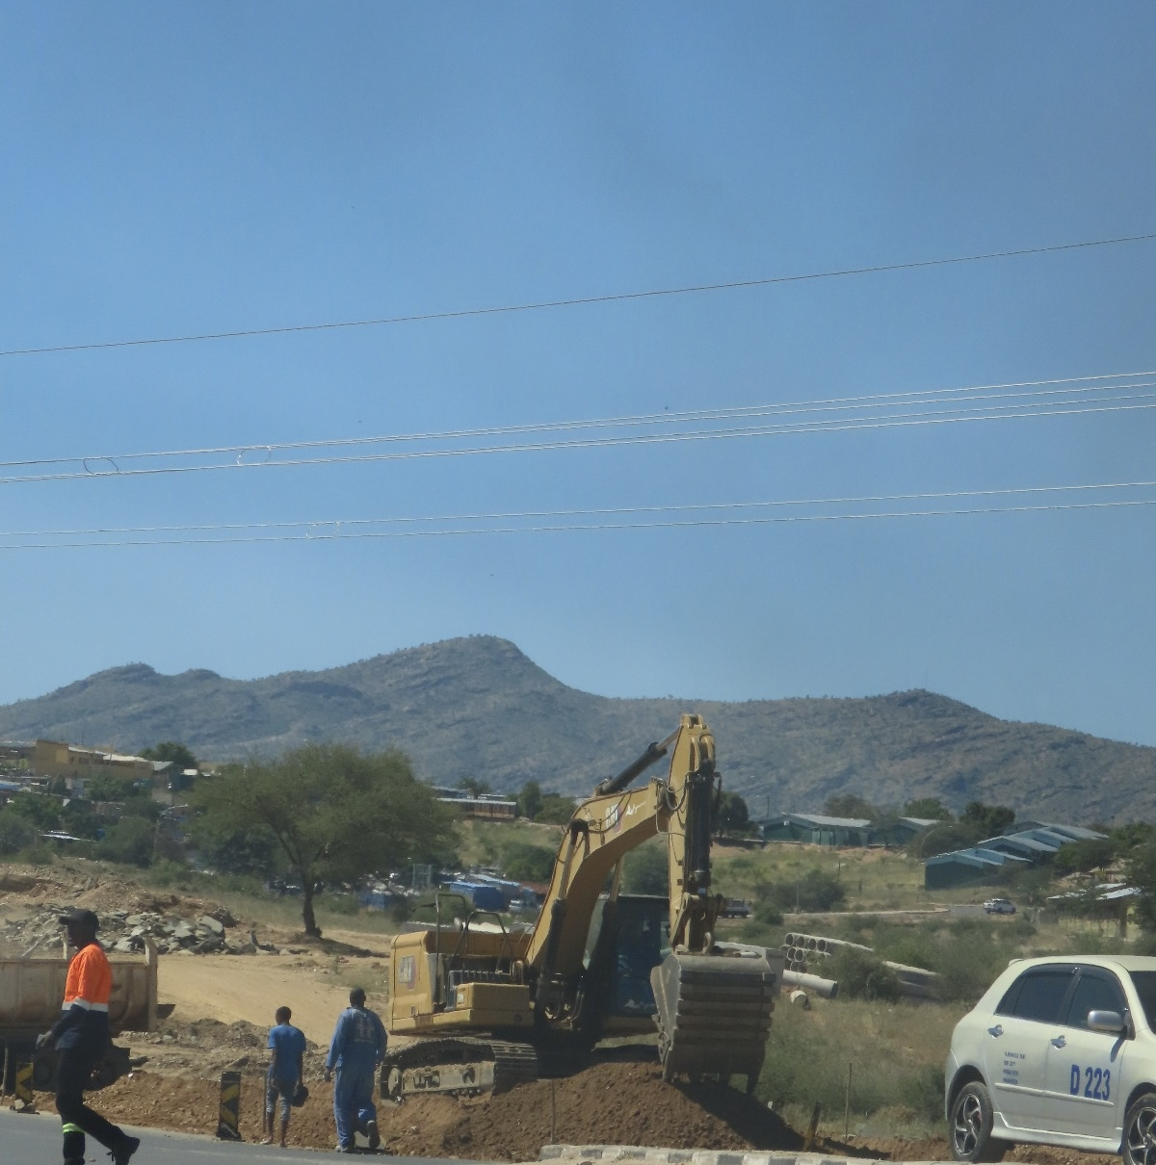

LoanWick
Two loans.
One machine.
DealPilot
Evidence before release
HackUTD
Challenge sponsor
Notes:
0:00–0:25. Imagine two loan applications landing on different desks. Two companies, two requests, one machine. Each company claims it owns the equipment. The question is what becomes visible when we connect the files. Introduce LoanWick’s DealPilot. The photo is illustrative, not evidence from the criminal case.
https://commons.wikimedia.org/wiki/File:Road_construction_and_repairing.jpg
Logo source: https://cdn.gs.com/images/goldman-sachs/v1/gs-vertical-lg.svg. Goldman Sachs identifies the hackathon challenge sponsor. LoanWick is the team project.

Slide 2
REAGOR DYKES AUTO GROUP
A real Texas lending-fraud case
$50M
7 years
CFO prison sentence
Broader wire fraud scheme
JUNE 2019
JANUARY 2022
CFO pleads guilty
Court imposes sentence
Challenge sponsor
Source: U.S. Department of Justice
Notes:
0:25–1:00. Reagor Dykes was a Texas auto group. DOJ described a $50 million wire fraud conspiracy. CFO Shane Smith pleaded guilty in June 2019. In January 2022, a judge sentenced him to seven years in prison. The overall scheme involved multiple methods. We focus on one documented pattern: financing vehicles that had already been pledged to other lenders. The $50 million is the broader scheme amount, not losses solely attributable to duplicate collateral.
https://www.justice.gov/usao-ndtx/pr/eighth-reagor-dykes-defendant-pleads-guilty-wire-fraud-conspiracy
https://www.justice.gov/usao-ndtx/pr/reagor-dykes-cfo-sentenced-7-years-prison-wire-fraud-conspiracy
Logo source: https://cdn.gs.com/images/goldman-sachs/v1/gs-vertical-lg.svg. Goldman Sachs identifies the hackathon challenge sponsor. LoanWick is the team project.

Slide 3
One vehicle, multiple loans
The documented practice: “double flooring”
Lender A
Same vehicle
Lender B
Existing loan
Same identity
Another loan
The connection matters as much as the document.
Challenge sponsor
Simplified mechanism from DOJ’s 2019 account. Multiple liens alone do not prove fraud.
Notes:
1:00–1:30. DOJ documented employees using cars already pledged as collateral to other lenders. They called the practice double flooring. This schematic explains that mechanism. It does not name the lenders for any particular transaction or assert that all multiple liens are fraud. The important facts are what was disclosed, what was promised and what prior claims existed.
https://www.justice.gov/usao-ndtx/pr/eighth-reagor-dykes-defendant-pleads-guilty-wire-fraud-conspiracy
Logo source: https://cdn.gs.com/images/goldman-sachs/v1/gs-vertical-lg.svg. Goldman Sachs identifies the hackathon challenge sponsor. LoanWick is the team project.

Slide 4
Two applications share EX-0042
$550,000
The same asset connects both claims
in loan requests
Cedar
EX-0042
Granite
100% ownership
Shared asset
100% ownership
Cedar $250,000
Granite $300,000
Two cited schedules. One unresolved contradiction.
Challenge sponsor
Synthetic case. The figures are requested amounts, not proven losses.
Notes:
1:30–2:00. Now clearly separate the real story from our synthetic case. Cedar asks for $250,000 and Granite asks for $300,000. Both claim exclusive ownership of EX-0042. That is $550,000 in requests affected by the contradiction, not money saved or proven fraud. This image is the graph rendered by our actual visual-polish branch.
Actual fixture UI, claude/visual-polish a18838cf9e0706fa3ac8d00b0815cb062cc2e06e.
Diagram restyled from the actual fixture graph; labels preserve the same case facts.
Logo source: https://cdn.gs.com/images/goldman-sachs/v1/gs-vertical-lg.svg. Goldman Sachs identifies the hackathon challenge sponsor. LoanWick is the team project.

Slide 5
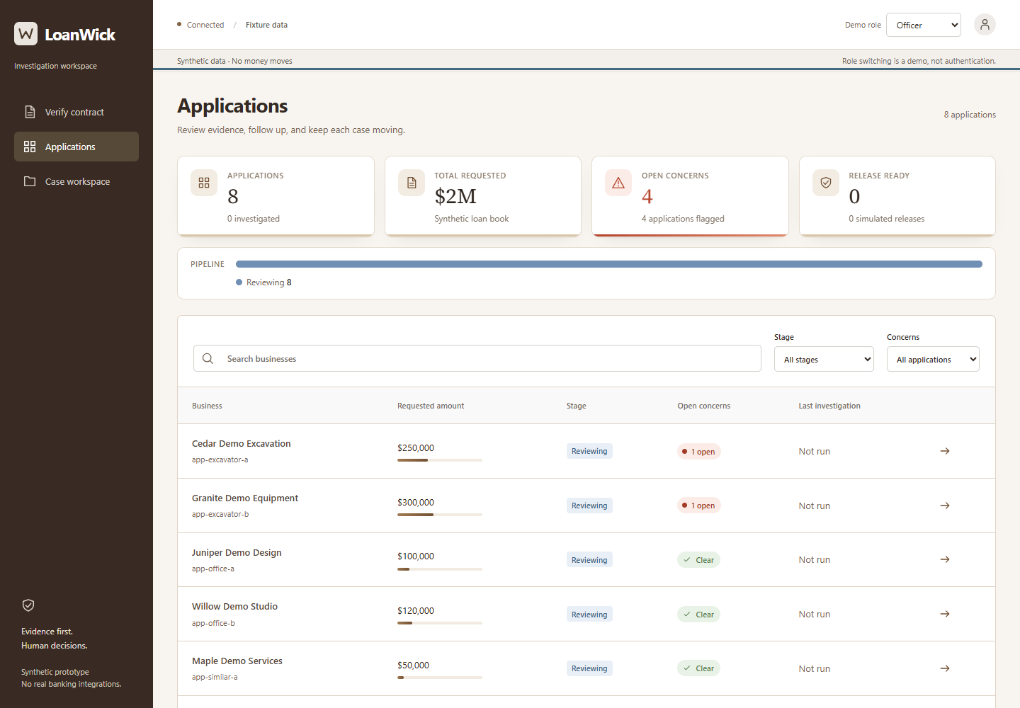
From portfolio to the evidence
01
Open Cedar
02
Inspect the
linked claims
Challenge sponsor
Live demo cue: Applications, then Cedar Demo Excavation. Fixture mode.
Notes:
2:00–3:00. Switch to http://127.0.0.1:5176/applications. Show the eight synthetic applications. Open Cedar, inspect the conflict graph, and show the source excerpts from both borrowers. The summary points to a specific inconsistency and the source documents let the officer inspect it. The screen says Fixture data. The demo uses local deterministic checks, not a connected NVIDIA model.
Actual screenshot of the running visual-polish branch.
Logo source: https://cdn.gs.com/images/goldman-sachs/v1/gs-vertical-lg.svg. Goldman Sachs identifies the hackathon challenge sponsor. LoanWick is the team project.

Slide 6
How a loan moves through DealPilot
Current evidence at every decision
01
02
03
Intake
Compare evidence
Conflict
Hold and ask
Application and documents
Match IDs and ownership claims
Request proof or a correction
No conflict
06
05
04
Simulate release
Human review
Recheck
Current checks. One receipt.
Verify documents and payment
Investigate the latest evidence
Payment details changed? Reverify before release.
Challenge sponsor
Notes:
3:00–3:40. Start with the application and its documents. We compare evidence across deals. If the claims conflict, release stays on hold while we ask the borrower for ownership proof or a correction. We then rerun the investigation on the latest evidence. If there is no conflict, the case can proceed directly to human review. The reviewer resolves concerns and verifies the current documents and payment instructions. Only then can the system record one simulated release. If payment details change, the old payment verification no longer applies. No money moves.
Logo source: https://cdn.gs.com/images/goldman-sachs/v1/gs-vertical-lg.svg. Goldman Sachs identifies the hackathon challenge sponsor. LoanWick is the team project.

Slide 7
The release gate stays visible
Release on hold
Collateral
Documents
Payment
Investigation
Concerns
Pending
Pending
Pending
Not run
Unresolved
New evidence requires a fresh review.
The reviewer decides using the current record.
Challenge sponsor
Fixture state: all five conditions remain unmet. No release has occurred.
Notes:
3:40–4:20. This is an actual screenshot of the fixture’s release gate. It shows zero of five conditions met in the initial state. Current collateral, documents, payment checks, investigation and unresolved concerns all matter. Show the blocker instead of asserting that a risk score has approved the loan. A fresh payment document must invalidate the old payment check. No money moves in the prototype.
Actual fixture release gate screenshot from the running visual-polish branch.
Gate diagram restyled from the fixture screen. All five initial conditions remain unmet.
Logo source: https://cdn.gs.com/images/goldman-sachs/v1/gs-vertical-lg.svg. Goldman Sachs identifies the hackathon challenge sponsor. LoanWick is the team project.

Slide 8
LoanWick / DealPilot
The relationship
changes the decision.
Before the money moves,
the evidence should agree.
Challenge sponsor
Shown: synthetic fixtures and deterministic checks. No money moves.
Notes:
4:20–5:00. Return to the real story. Reagor Dykes shows why relationships between loan records matter. Our demo makes one such contradiction visible, keeps its sources attached, and provides a way to resolve it before release. What we showed uses synthetic fixtures and deterministic checks. SpacetimeDB is the shared backend; a connected NVIDIA investigation and document intake still need separate verification. Close with: Before the money moves, the evidence should agree.
https://www.justice.gov/usao-ndtx/pr/eighth-reagor-dykes-defendant-pleads-guilty-wire-fraud-conspiracy
Logo source: https://cdn.gs.com/images/goldman-sachs/v1/gs-vertical-lg.svg. Goldman Sachs identifies the hackathon challenge sponsor. LoanWick is the team project.

